Slide 1
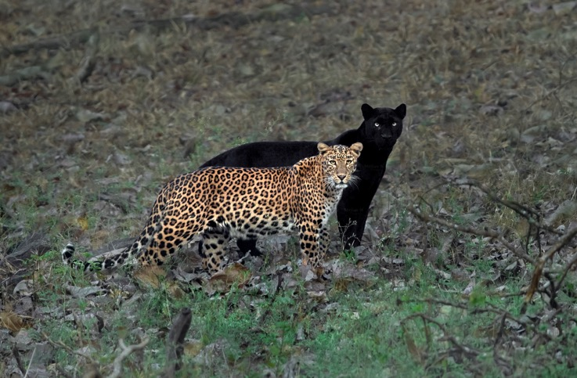
Qualitative vs. quantitative traits
Qualitative trait
Controlled by single, Mendelian gene
Simple evolutionary models apply
Quantitative trait
Controlled by multiple genes and environment
Predictions using the breeder’s equation
Quantitative genetics reveal underlying genomic architecture

Slide 2
Discussion questions
In relation to the R exercise
Is your estimate of eye size at generation 300 an overestimate or underestimate? Why? How would gene flow between populations impact your prediction?
Why are some beach mouse traits not normally distributed? What are the general lessons you learned from the QTL analyses? Do you think we captured all relevant genes?
What if I told you that QTL analyses in Atlantic coast beach mouse populations revealed completely different QTLs? How would you interpret that?
Does a significant association between certain genes and severe COVID-19 cases mean high heritability? What genes do you think may be associated with COVID-19 susceptibility, and why should we care knowing about them?
Before you get started:
Make sure to introduce each other
Choose a timekeeper
Choose a reporter
Breakout groups for 20 minutes

Slide 3
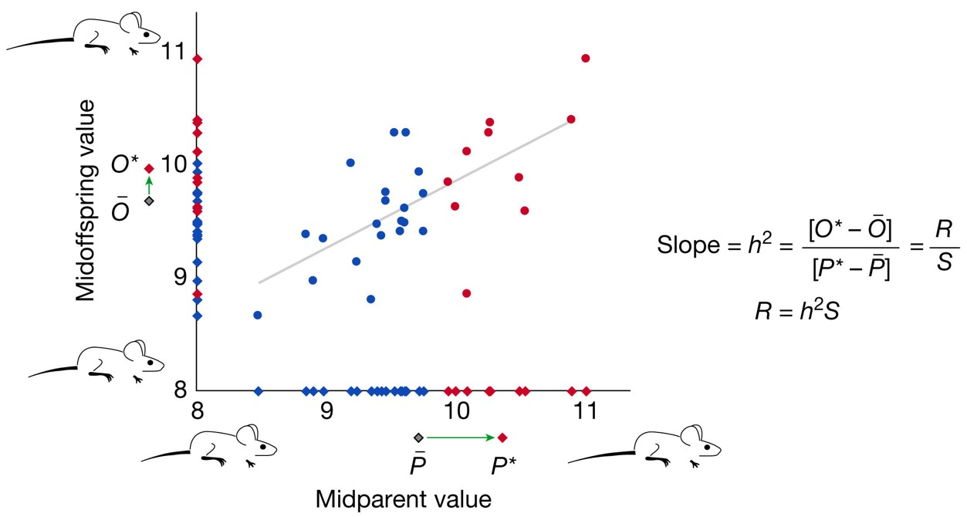
Predicting the response to selection
Breeder’s equation
R = h²*S
t₃₀₀ = t₀ – 300*R
Is your estimate of eye size at generation 300 an overestimate or underestimate? Why?
How would gene flow between populations impact your prediction?

Slide 4
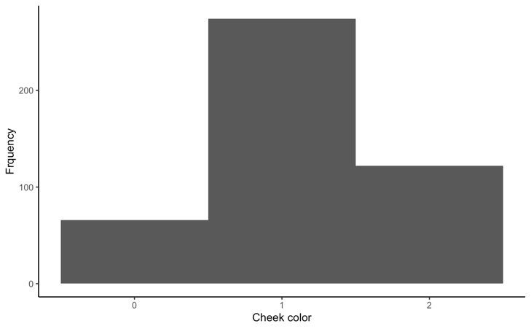
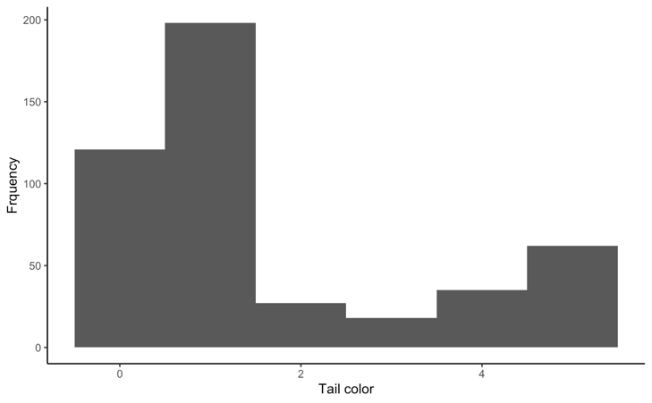
Dissecting complex traits: QTL mapping
What did you observe?
Why are not all quantitative traits normally distributed?

Slide 5
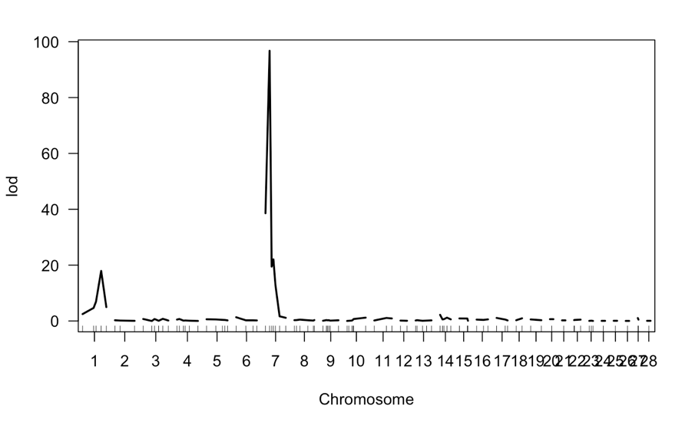
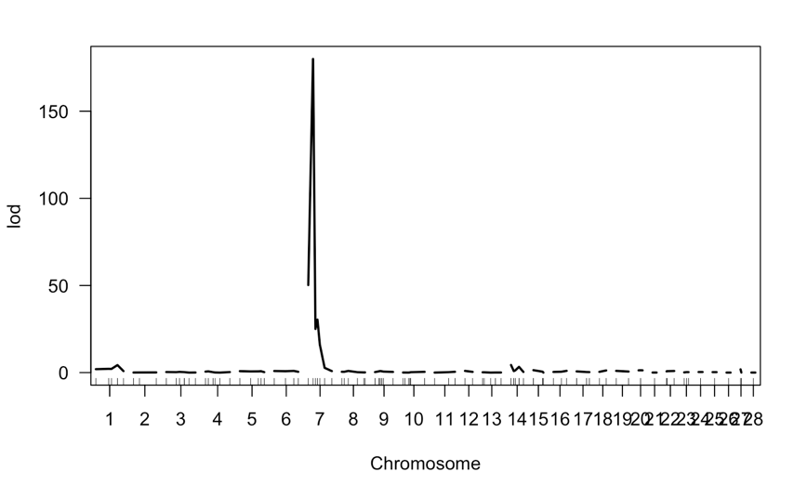
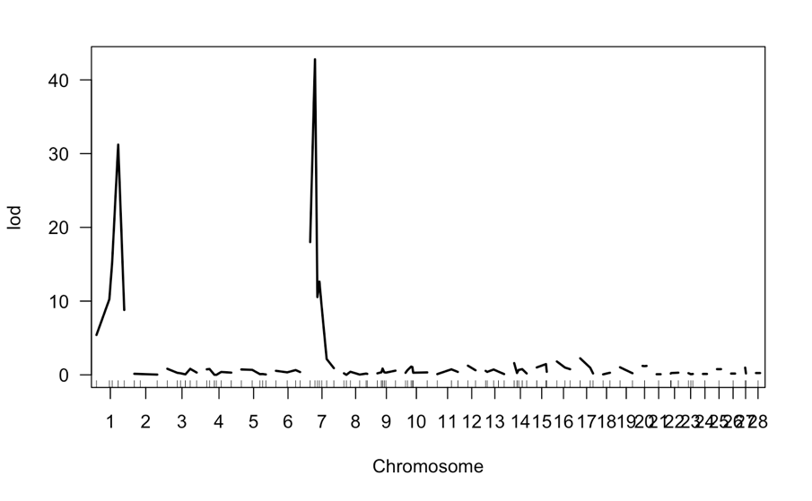
Dissecting complex traits: QTL mapping
What are the general lessons you learned from the QTL analyses? Do you think we captured all relevant genes?

Slide 6
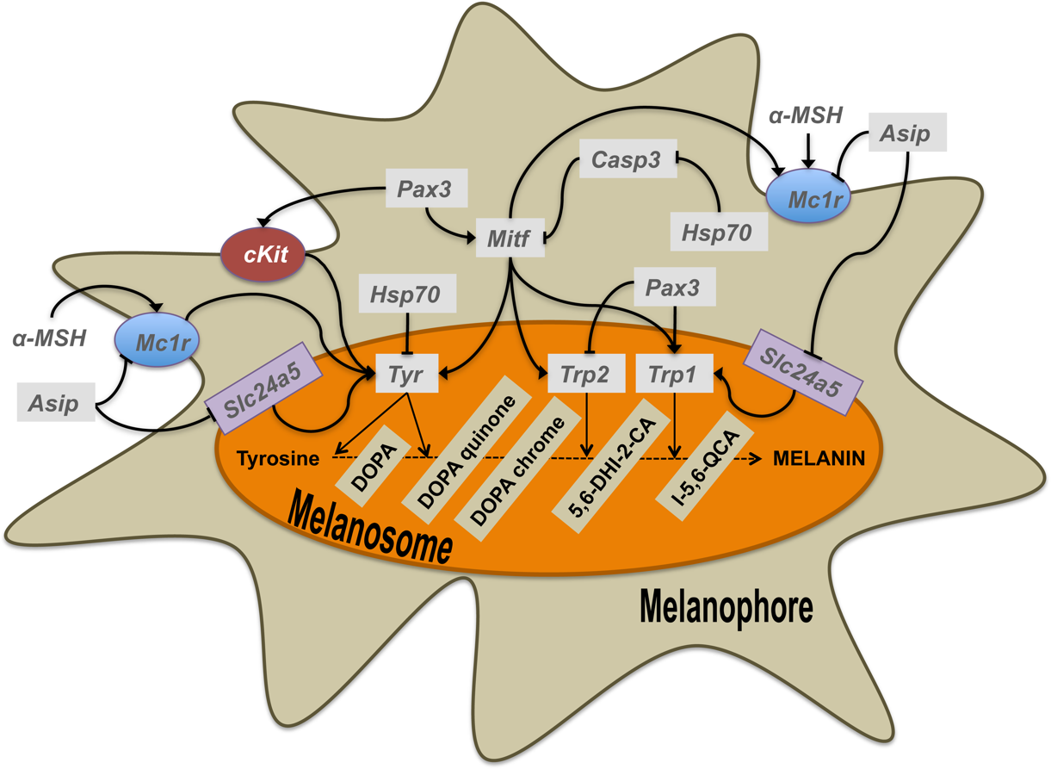
Dissecting complex traits: QTL mapping
What did you observe?
MC1R (melanocortin-1 receptor)
Agouti (Agouti signaling protein, Asip)
KIT (c-kit receptor)

Slide 7
Coat color evolution
What if I told you that QTL analyses in Atlantic coast beach mouse populations revealed completely different QTLs? How would you interpret that?
Mc1r frequency

Slide 8
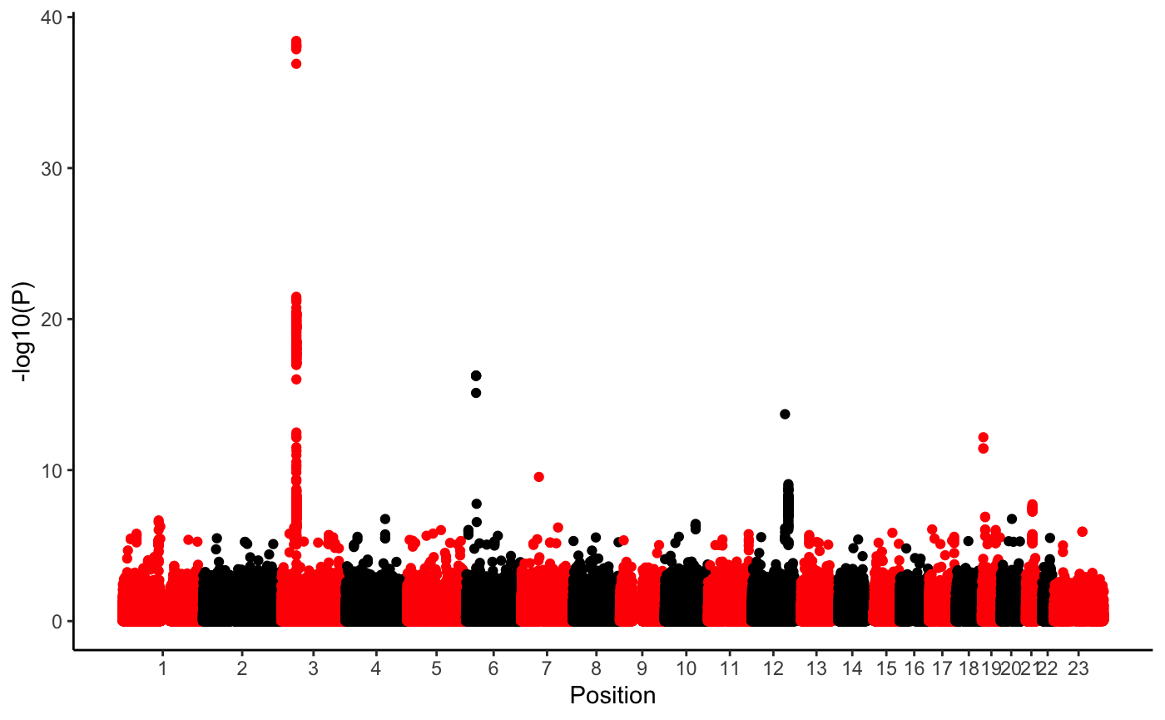
Dissecting complex traits: GWAS
Does a significant association between certain genes and severe COVID-19 cases mean high heritability? What genes do you think may be associated with COVID-19 susceptibility, and why should we care knowing about them?

Slide 9
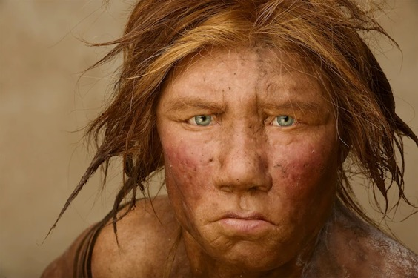
Dissecting complex traits: GWAS
Genetic regions associated with susceptibility to COVID-19 were introgressed from Neanderthals

